Slide 1
Security Module
Introduction
High Level Architecture
Permissions in Details
Security for Dynamic Sections
Audiences
Authenticating Users
Users Management

Slide 2
Introduction
Securing products should be smooth, robust and without any breach
Good security modules should:
Trim what the user is not allowed to see
Secure calls to server
Security modules give access for Holders to Assets
Our security module is common for all products
Our Security module puts a middleware between holders and assets

Slide 3
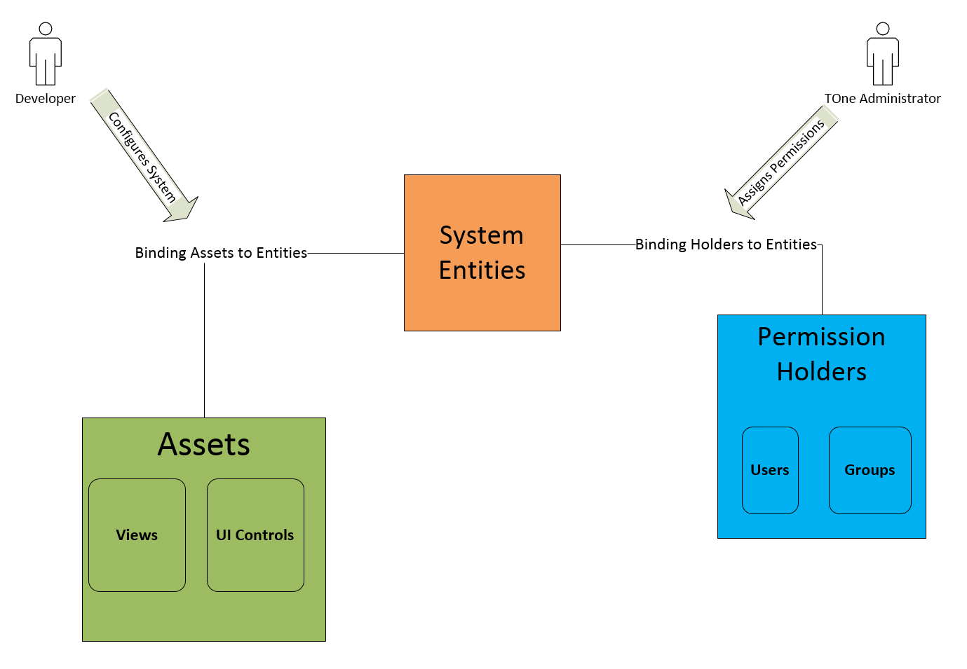
High Level Architecture

Slide 4
System Entities Tree
Represents the business parts of the system in a tree form
Differs from product to another and client to another
Has Node name + Flags. Ex: Billing: View, Add, Edit
The responsibility of Developers

Slide 5
Assets
Can be a page, a button or a report for example
Each asset has required permissions attribute
Required Permissions can be:
Billing: View
Administration: View | Edit
Billing: View & Report: View
The responsibility of Developers

Slide 6
Permissions
The link between holders and System Entities Nodes
The tree supports multiple features:
Inheritance
Break Inheritance
Full Control
Deny
Users and Groups
This link results at runtime into Effective Permissions per holder
The responsibility of Admin

Slide 7
System Actions
A solution to make maintenance easier
A system action can be:
Private: with required permissions set to a specific value
Public: with required permissions set to NULL
The format of a system action is: module/Feature/Action
Examples:
VR_Sec/Group/AddGroup
VR_Sec/Permission/UpdatePermissions
VRCommon/City/GetCitiesInfo

Slide 8
Security Trimming
Prevents the user from seeing what he is not allowed to see
Applied on Menu Items:
Configuration is done by developers in database
Each view in the database is assigned an action name
Usually action names for this asset ends with “Get Filtered”
Applied on Buttons, Grid Actions and Popup actions:
Configuration is done by developers in JavaScript files
Each action is assigned an action name in the JavaScript file
Usually action names for this asset ends with “Add Entity”, “Update Entity”…

Slide 9
Filters & Security Server Calls
Filters intercept each request between a client and the server
Filters can be like:
Authentication Filter
Authorization Filter
License Filter
The authorization filter will construct the action name dynamically from HTTP data
Example: ModuleName/ControllerName/ActionName
Then it checks if the logged in user is allowed to pass or no
In case user is not allowed, it returns a 403 response (Forbidden)

Slide 10
End of Permissions in Details Section
Go to an example
Add a new user with no permissions
Open the user in a different session > No pages are shown
Give this user view permission to Groups page
Give him Add permission
Remove all permissions and try to navigate to the page
Next section will discuss other parts of security module

Slide 11
Security For Dynamic Sections
Generic Rules, Business Processes, Dynamic Pages and other modules are considered as dynamic sections
A dynamic section usually generates pages or components at runtime, no need for development
Dynamic sections needs a special kind of security

Slide 12
Securing Generic Rules
When creating a generic rule. The rule should be configured to be shown in a specific rules page. This part is done by developers.
The configuration for the rule page is done in the database
Mainly at settings column of View table
At Rule Definition Page, developers will also assign each rule a system entity and a permission flag. (This is called Rule Definition Security Configuration).
Linking View to a specific node. Example: Whs_Sales_Rules: View
Linking Add to a specific node. Example: Whs_Sales_Rules: Add
Linking Edit to a specific node. Example: Whs_Sales_Rules: Edit
Navigate to one type of Rule pages and give an example

Slide 13
Audiences
It is usually used for public pages as an additional step for trimming
It is not intended to secure pages (only trimming)
An administrator can set audiences for any View in the system
Audiences are intended to trim Dynamic Pages (BI)
To set audiences for a specific view:
An administrator can navigate to Configuration > System > Views
Edit a view and set its audiences

Slide 14
Authenticating Users
When a user logs in, a number of checks occurs to make sure he has access
If everything is ok, a TOKEN is created for this user and saved in a cookie
Cookies created by security module begins with “Vanrise-AccessCookie”
The created token is encrypted with an encryption key
The encryption key is configurable (key Name = “EncryptionSecretKey”)
A cookie will expire after 1 day
A cookie will be deleted after the user logs out from the system
Cookie’s data will be added to each request and passes through Authentication Filter for the sake of validating the user token

Slide 15
Login Procedure
Check | Result
If user does not exist | User Not Exists
If user is inactive | Inactive
If temp password and provided password do not match | Activation Needed
If both (temp, user password) and provided password do not match | Wrong Credentials
All is ok | Succeeded

Slide 16
Request Authentication Procedure
Check | Status Code | Message
Token not found in the request | Unauthorized | Could not find a token to authorize this request
Token is not valid | Unauthorized | Invalid Token
Token expired | Unauthorized | Token Expired
For Cloud Applications and cloud data not found | Unauthorized | You don't have access to this application
For Cloud Applications and Tenant License expired | Payment Required | License Expired
Any other problem | Unauthorized | Invalid Token (You can also find details about the error in logs)

Slide 17
Users Management
When created, a user will be assigned a Temp Password
This password is sent via an email to the email of that user
When the user logs in for the first time, activation is needed
After activating and providing a new password, temp password is deleted
All passwords are protected with Hashing Algorithm (Salt is added to increase the level of protection)

Slide 18
Questions and Answers

Slide 19
Questions and Answers
Prepared on: 28/12/2016
Presented by: Mortada Issa

